Slide 1


Model-Driven Enterprise Architecture
based on TOGAF and ArchiMate
MYKHAYLO STEPANYAK
December 2022

Slide 2

Agenda
01
Self-Introduction
02
Why do you need an architecture repository?
03
Model-Driven Enterprise Architecture
04
Architecture Frameworks and Tools
05
Architecture Repository review
06
Q&A

Slide 3

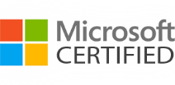

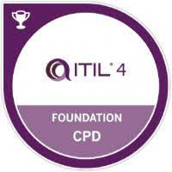

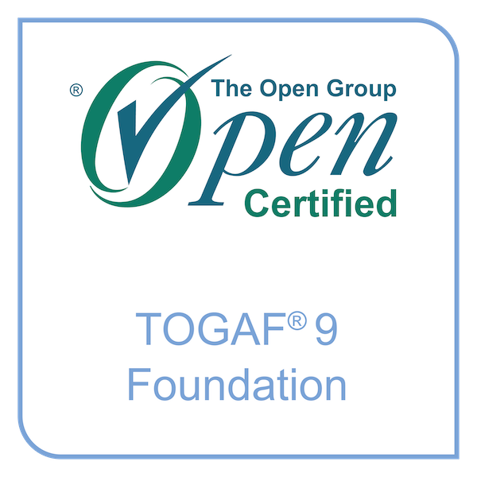
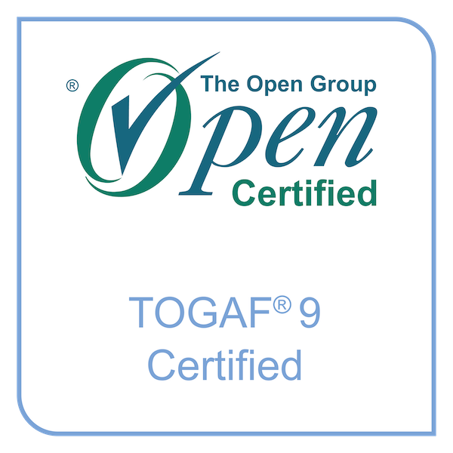
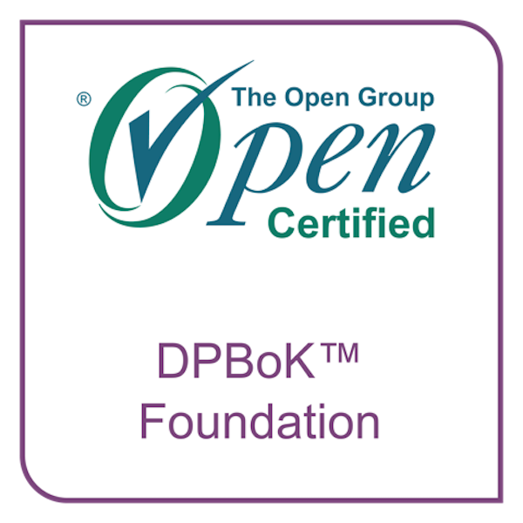
Self-introduction
Mykhaylo Stepanyak
Solution Architect L2
15+ years in IT industry, certified in ITIL, DPBoK, TOGAF, SEI, AWS, etc.
of dev, software and systems architecture background
current role: Information Technology Architect
- improve value streams through enterprise information solutions
- define technical requirements, principles and models that guide
solution decisions for the ecosystem
Engineer<T> where T : C# | AWS | Azure | JavaScript
More… go to
Professional
@mstepanyak

Slide 4
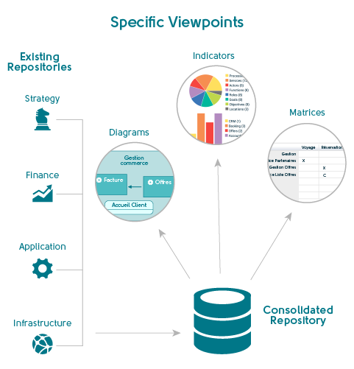
Why do you need an architecture repository?
Problem
Lack of clearly defined architecture processes, roles and responsibilities for strategic architecture vision, architecture design and architecture governance in place.
Solution
Create a repo to provide a holistic view of an organizational landscape.
Act as a modular, scalable framework that enables organizational transformation.
Transparency
Traceability
Notes:
Operating a mature Architecture Capability within a large enterprise creates a huge volume of architectural outputs.
Effective management and leverage of these architectural work products require a formal taxonomy for different types of architectural asset alongside dedicated processes and tools for architectural content storage.
I decided to create the Architecture Repository that allows an enterprise to distinguish between different types of architectural assets that exist at different levels of abstraction in the organization.
The importance of repository coherence
Enterprise/Solution Architects, IT Engineers often document architecture descriptions in diagrams and documents, and that can be enough for small and/or short-term projects.
They can use Power Point or Visio to draw the diagrams. And use spreadsheets to maintain the repository of system elements.
However, larger and longer-term projects and programmers require a more flexible form of documentation - that can be manipulated by several architects and presented in a variety of ways.
It requires a repository from which up-to-date views can be generated.
An architecture repository itself relates elements in different views to each other. And must be coherent across all views and stages.
A Repository itself is a single File, DBMS database or Cloud Server address that contains one or more Projects.

Slide 5

Enterprise architecture repository purposes
Understand the system described
- building and displaying a model of complex structures helps people to understand them
Relate IT to business
- ability to do traceability analysis, to show which assets relate to which goals, requirements and constraints
Identify potential changes
- ability to do gap analysis and cluster analysis, to spot areas where changes are desirable
Plan changes
- define a target or vision architecture by manipulating elements of the baseline architecture
Manage changes
- conduct impact analysis following any change proposal
Notes:
Define standards input/output
What value streams and capabilities do we have modern digital operating model
Establish Process decision making
Define how the new business service will be provided.
Identify how the existing business services are provided and find the components that can be reused for the new service.
Define the gaps that need to be closed to be able to provide the new service.

Slide 6
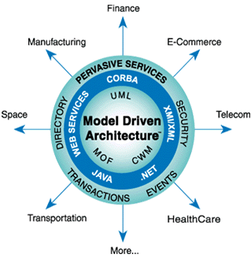
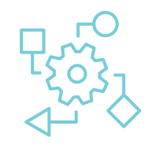
Model-driven architecture
Provides an approach for deriving value from models and architecture in support of the full life cycle of physical, organizational and IT systems.
Brings value by producing models at varying levels, from a conceptual view down to the smallest implementation detail.
https://en.wikipedia.org/wiki/Model-driven_architecture
Notes:
The MDA is OMG's method of developing applications and writing specifications, based on a platform-independent model (PIM) of the application or specification's business functionality and behavior.
A complete MDA specification consists of a definitive platform-independent base model, plus one or more platform-specific models (PSM) and sets of interface definitions, each describing how the base model is implemented on a different middleware platform.
A Model is a related group of content that expresses some focused aspect of a system or enterprise that is related by the modeling tools and paradigm used.
A Project is a group of models that has a single unifying purpose.

Slide 7
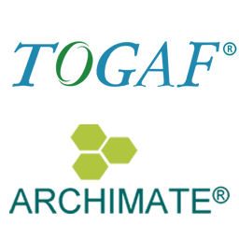
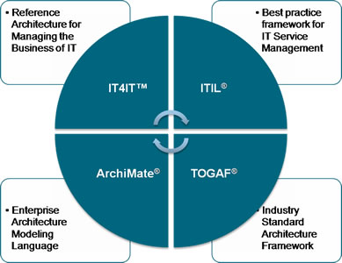
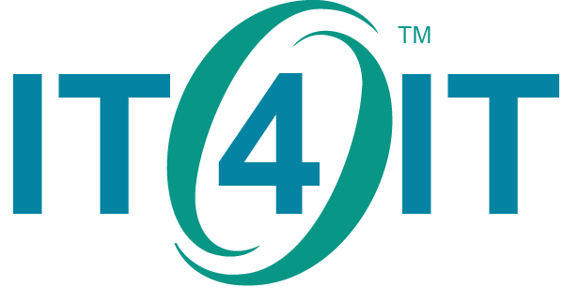
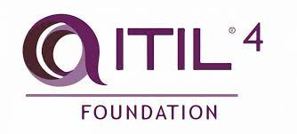
Architecture Frameworks and Tools
Relationship to TOGAF, ArchiMate and ITIL/IT Service Management
https://www.opengroup.org/it4it/relationships
Notes:
The Open Group Architectural Framework (TOGAF): TOGAF provides principles for designing, planning, implementing and governing enterprise IT architecture. The TOGAF framework helps businesses create a standardized approach to EA with a common vocabulary, recommended standards, compliance methods, suggested tools and software and a method to define best practices. The TOGAF framework is widely popular as an enterprise architect framework, and according to The Open Group it’s been adopted by more than 80 percent of the world’s leading enterprises.
The framework successfully combines people, data and technology to show a comprehensive view of the inter-relationships within an information technology organization
Archimate is industry standard that provides an instrument to support enterprise architects in describing, analyzing and visualizing the relationships among business domains in an unambiguous way
Archimate is an open an independent modeling language for enterprise architecture supported by leading EA tool vendors
ITIL 4: the framework for the management of IT-enabled services - https://www.axelos.com/certifications/itil-service-management/
ITIL 4 can help us to:
- understand how IT impacts strategy
- use the guiding principles to navigate change, streamline work and introduce flexible and collaborative working practices
- build trusted relationships with stakeholders and develop effective and timely communications
work with complex, adaptive systems and flexible processes that can adapt to changing environments
IT4IT: The most POWERFUL TOOL you have is TRANSPARANCY
!!!! -- Digital Management Capability for a IT using IT4IT
Most organizations have over 20 IT processes and dozens of IT management tools to manage their digital delivery.
But how do you create flow across all these fragmented parts? How to optimize and automate end-to-end value streams to deliver Better Value, Sooner, Safer, and Happier while improve Cost efficiency? There is only one thing that provides you the SUPERPOWER to achieve this, that is: having TRACEABILITY and TRANSPARANCY across your IT value streams, from Idea to production, from a Vulnerability to fix, from a Request to fulfill, etc. Yes, I realize this is easier said than done. But the biggest obstacle to improve your IT delivery is not understanding the bigger system of how all parts should be interconnected (see also the IT4IT reference architecture). The foundation is having a COMMON INFORMATION MODEL (OR DATA FABRIC), create visibility of all work in IT (including epics, projects, features, stories, test cases, defects, incidents, problems, changes, service requests, risks, vulnerabilities, security events, and many more…). Using Value Stream Management (VSM) and a DATA DRIVEN approach will enable you to optimize and continuously improve your IT value streams. Please have a look at my YouTube video: https://lnkd.in/eM72jub5 and subscribe to my channel: https://lnkd.in/eKYDmcPM

Slide 8
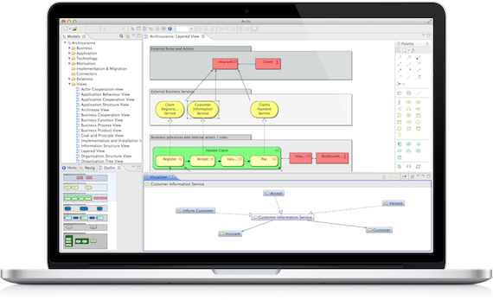
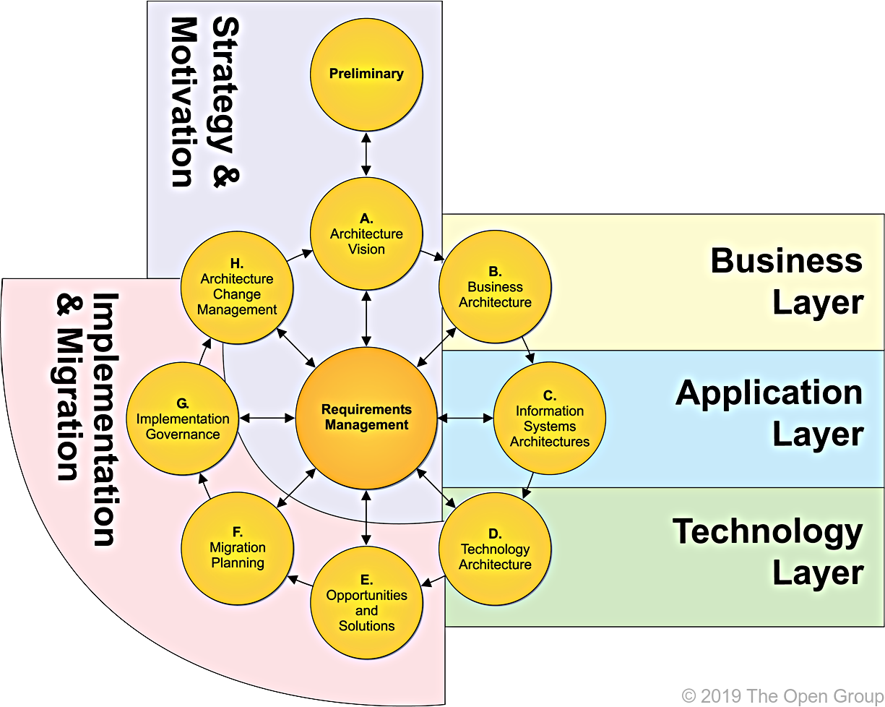
TOGAF Repository
with
Archimate
Design a mature enterprise architecture repository using ArchiMate
Architecture Development Method (ADM)
Notes:
The Architecture Development Method (ADM) is at the heart of TOGAF. The ADM helps businesses establish a process around the lifecycle of enterprise architecture. The ADM can be adapted and customized to a specific organizational need,
ArchiMate® metamodels organized by layers. To get the full picture of an element and to find all possible relationships across the different layers, you will need to go back and forth between multiple diagrams in different chapters of the ArchiMate® specification, as you will see shortly.
_______________________________________________________________________________________
which can then help inform the business’s approach to information architecture. ADM helps businesses develop process that involve multiple check points and firmly establish requirements, so that the process can be repeated with minimal errors.
Focused metamodels are our interpretation of ArchiMate's standard metamodels. ArchiMate® metamodels are great references, but they are organized by layer. To get the full picture of an element and to find all possible relationships across the different layers, you will need to go back and forth between multiple diagrams in different chapters of the ArchiMate® specification, as you will see shortly.

Slide 9
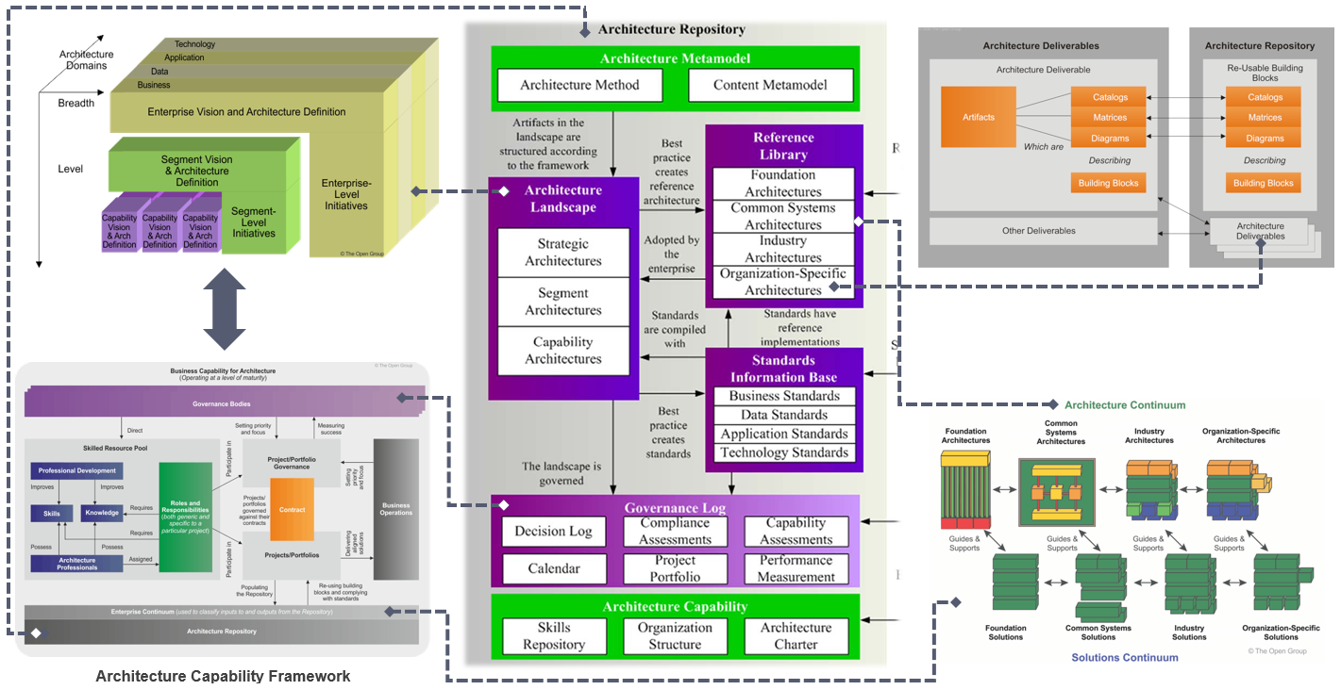
TOGAF Architecture Repository
https://pubs.opengroup.org/architecture/togaf9-doc/arch/chap37.html
Notes:
As I mentioned before Operating a mature Architecture Capability within a large enterprise creates a huge volume of architectural output. Effective management and leverage of these architectural work products require a formal taxonomy for different types of architectural asset
This section provides a structural framework for an Architecture Repository that allows an enterprise to distinguish between different types of architectural assets that exist at different levels of abstraction in the organization.
This Architecture Repository is one part of the wider Enterprise Repository, which provides the capability to link architectural assets to components, view.
The Architecture Metamodel describes the organizationally tailored application of an architecture framework, including a method for architecture development and a metamodel for architecture content
The Architecture Capability defines the parameters, structures, and processes that support governance of the Architecture Repository
The Architecture Landscape presents an architectural representation of assets in use, or planned, by the enterprise at particular points in time
The Standards Information Base captures the standards with which new architectures must comply, which may include industry standards, selected products and services from suppliers, or shared services already deployed within the organization
The Reference Library provides guidelines, templates, patterns, and other forms of reference material that can be leveraged in order to accelerate the creation of new architectures for the enterprise
The Governance Log provides a record of governance activity across the enterprise
The Architecture Requirements Repository provides a view of all authorized architecture requirements which have been agreed with the Architecture Board
The Solutions Landscape presents an architectural representation of the Solution Building Blocks (SBBs) supporting the Architecture Landscape which have been planned or deployed by the enterprise

Slide 10
TOGAF Architecture Repository review
Three thing to bear in mind about repository maintenance
First, if the repository is not internally cohesive and coherent, people will distrust it.
Second, you’ll need to understand the relationships in the repository meta model.
And practice, you won’t manage to capture all the architecturally significant entities and relationships in one repository.
Notes:
Metamodels are the blueprints that guide the development of architectural artifacts such as diagrams.

Slide 11
Enterprise communication using ArchiMate
Methodology and tools are the infrastructures of architecture
- Maintaining them requires an ongoing investment
- Every project can either strengthen or weaken them
- TOGAF and Archimate are based on a broad consensus
- Experienced architects find them familiar and can adopt them quickly
Standard languages and methods are increasingly valuable as collaboration across organizations, cultures, and geographies becomes ubiquitous.

Slide 12
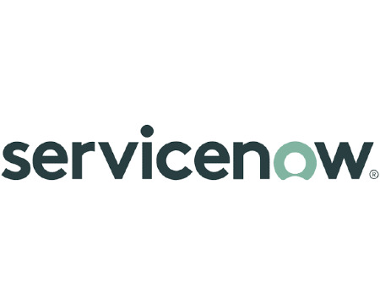
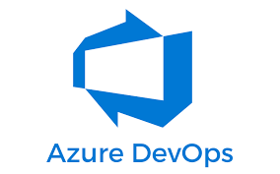
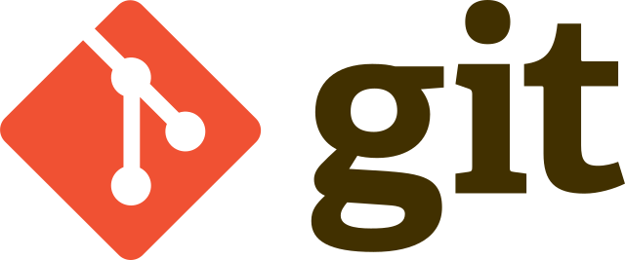
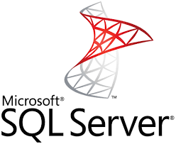
Archi Integration Plugins

Slide 13
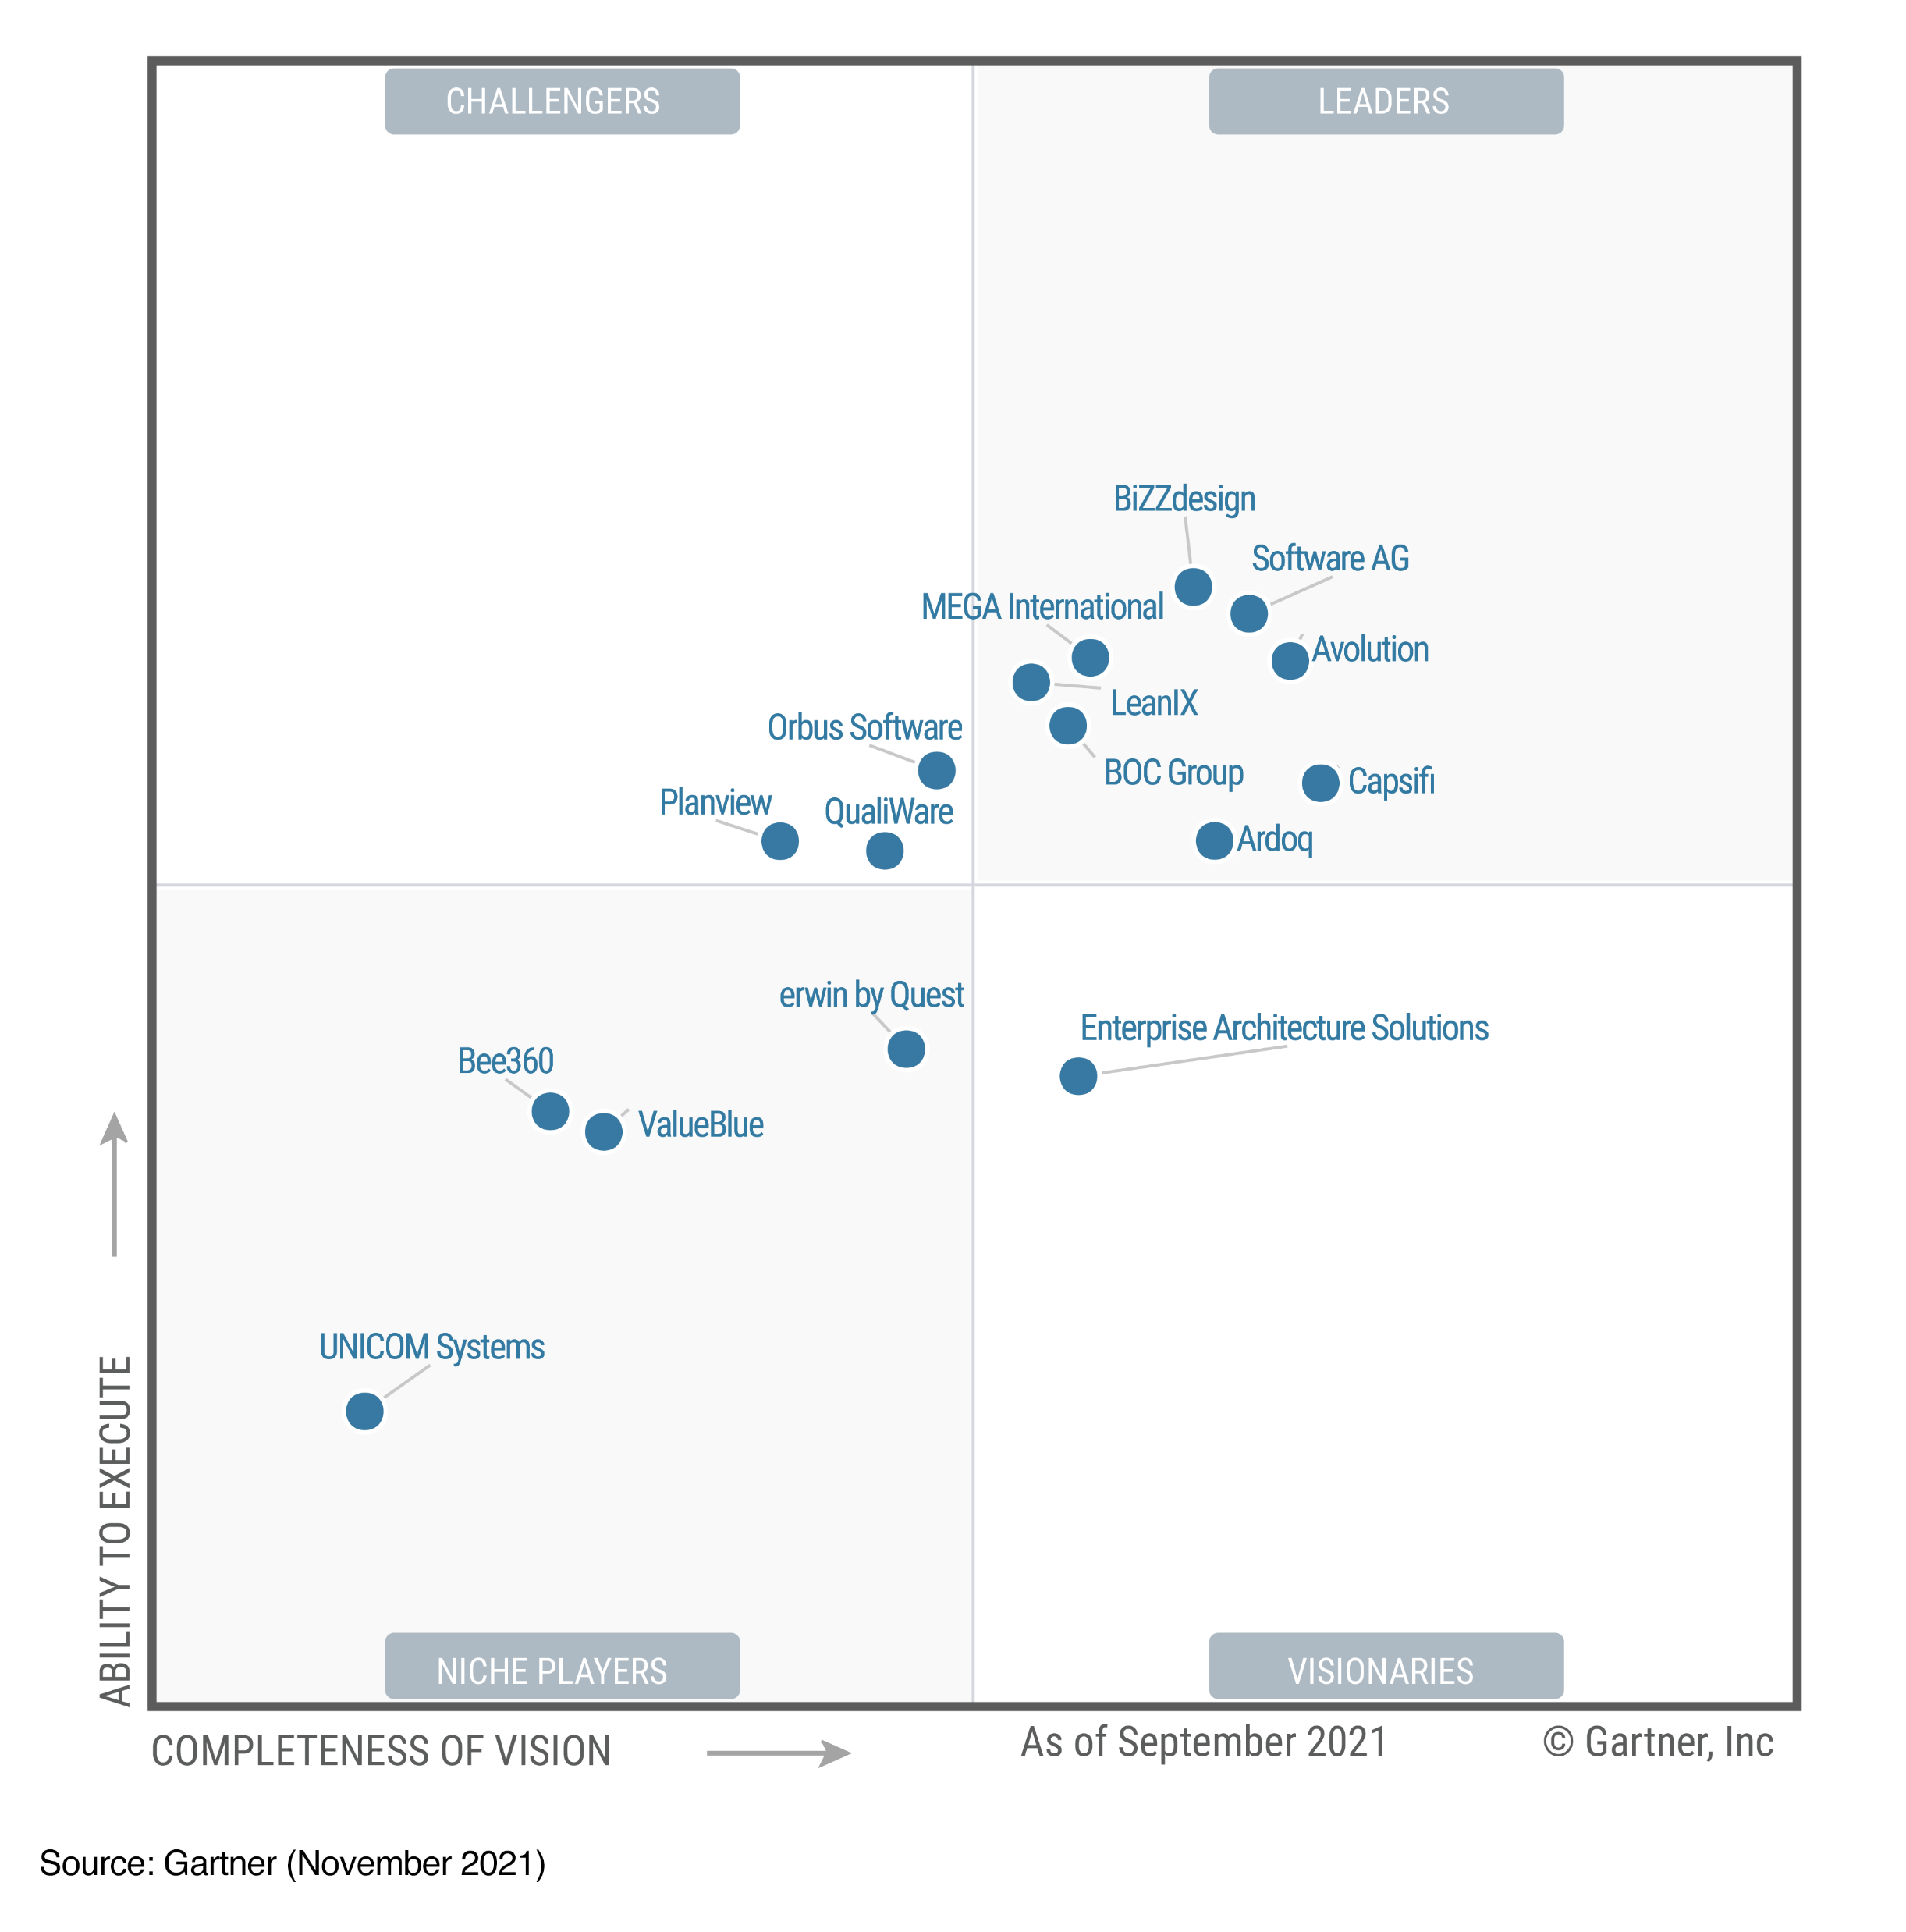
2021 Gartner Magic Quadrant for Enterprise Architecture Tools

Slide 14
Lessons learned as an Enterprise Architect
EA can deliver many benefits to Customer organization.
1. However, to increase the likelihood of success, the EA group needs to deliver value to the business and cannot be seen solely as IT.
2. Support from the Customer organization is needed.
3. Traceability from the business goals and vision to engineers often does not exist.
Define the next steps to take:
1. Create an EA value proposition based on enterprise needs that clearly articulates the expected contributions of the EA function.
2. Establish the EA fundamentals (vision and mission statement, goals and objectives, and principles) needed to position the EA function to deliver the promised value proposition.
3. Identify the services that EA has to provide to the organization to deliver on the promised value proposition.

Slide 15
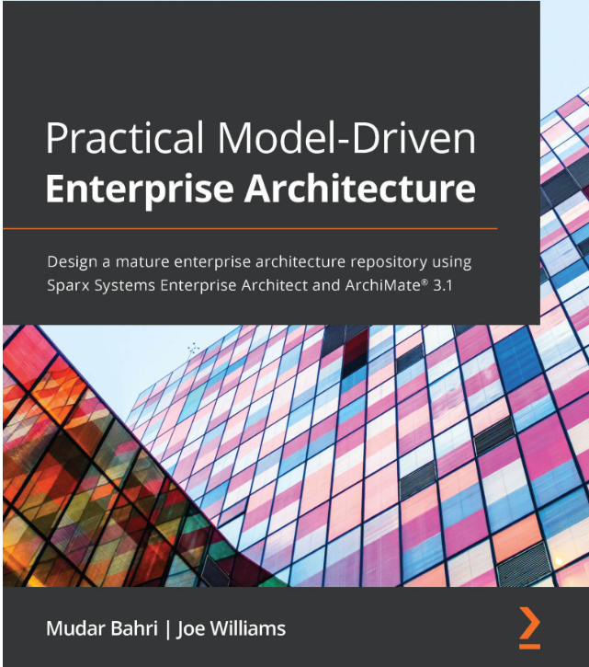
Helpful links
Model Driven Architecture - link
Business Architecture Info - link
The TOGAF® Standard, 10th Edition – link
Archi: Architecture modeling – link
ArchiMate® 3.1 Specification – link
The IT4IT™ Reference Architecture – link1 link2
ITIL® 4: framework for the management of IT-enabled services – link
Practical Model-Driven Enterprise Architecture- link

Slide 16

Thank you!
For more information, contact
Mykhaylo Stepanyak
Solution Architect II
Mykhaylo_Stepanyak@epam.com
Lviv, Ukraine

